Slide 1
Business Process Engineering
Week 2

Slide 2
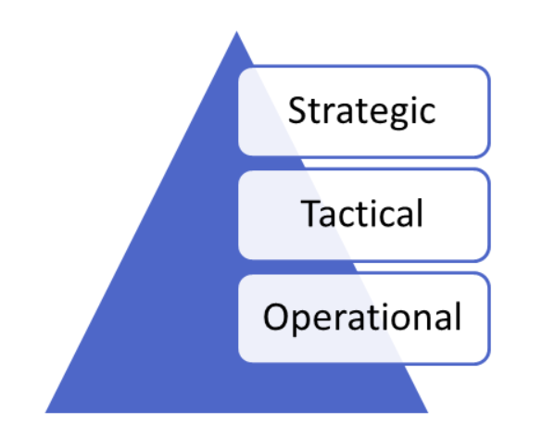
Level of information in an organization

Slide 3
Strategic
Top level of the organization
used by directors to decide strategic direction of organization
long term information
summarized form
information about whole organization
Futuristic information

Slide 4
Tactical
Middle level of Organization
Used in resource allocation decisions
both short term and long term
used by managers of departments
summarized form but less summarized that strategic information

Slide 5
operational
Low level.
Information need for daily tasks
Tasks specific information
Short term requirement
Used by supervisors to handle tasks at operational level

Slide 6
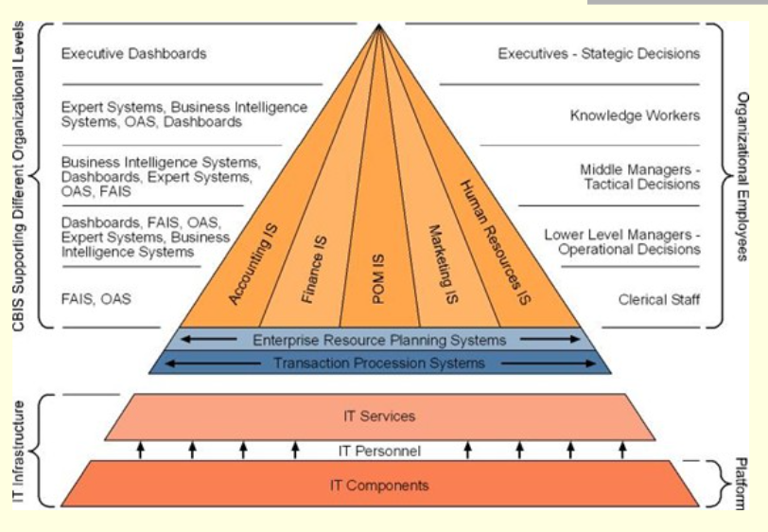

Slide 7
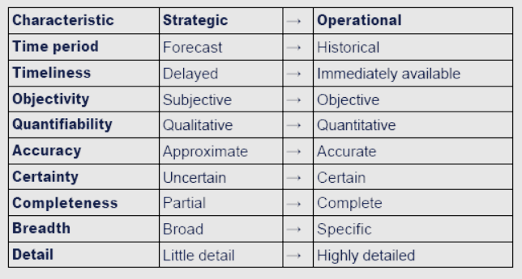
Characteristics of Information

Slide 8
What is Business Process Management?
Business process management (BPM) is how a company:
creates,
edits, and
analyzes
the predictable processes that make up the core of its business.

